Slide 1
Power BI Interactive Dashboard
Summary of Actions and Visuals Used

Slide 2
Page 1: Summary of Sales
Displays total sales value (2.30M) at a glance.
'Sum of Sales by City' - Line chart showing city-wise sales trends.
City selection slicer to filter visuals dynamically.
'Sales by Category' - Horizontal bar chart comparing Technology, Furniture, and Office Supplies.
Navigation button on left redirects to Total Sales page.
Grouping is also performed for the navigation button

Slide 3
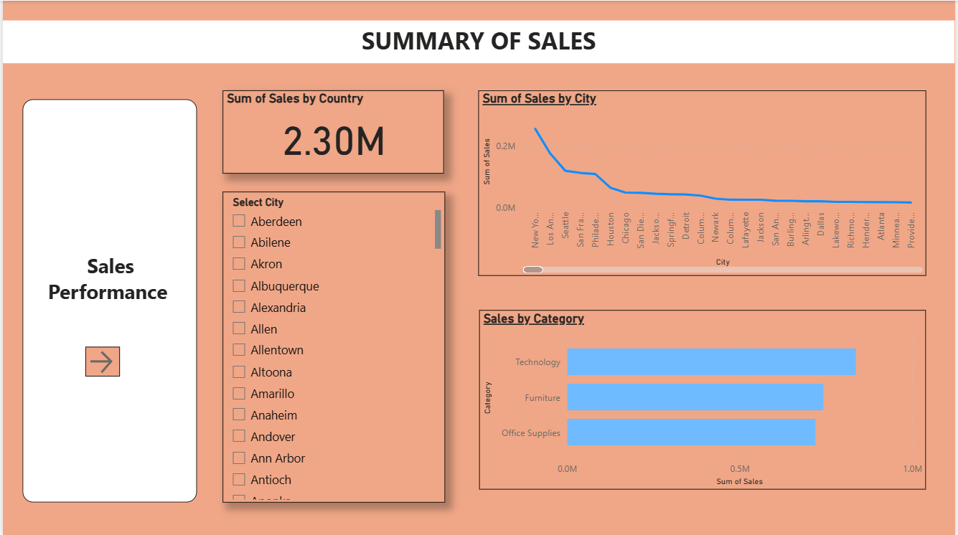

Slide 4
Page 2: Total Sales
'Sum of Total Sales by State' - Treemap for state-wise sales contribution.
'Total Sales by Region' - Funnel chart comparing West, East, Central, and South.
'Total Sales of Items' - Table of sub-categories with sales values.
'Total Sales by Year' - Table summarizing annual sales performance.
Back navigation button to return to the previous page.

Slide 5
